Slide 1

Car Sales Analysis
FINAL PRESENTATION: ADTA 5240

Slide 2

Harvesting, Storing & Retrieving Data Adta - 5240
TEAM MEMBERS:
Nishith Reddy Mannuru – 11467417
Adnan Shareef – 11643287
Praveen Reddy Kadasani – 11597360
Aseef Basha Shaik – 11601530
Yog Chaudhary – 11727095

Slide 3

Data Set Information
The dataset was gathered from Kaggle: https://www.kaggle.com/datasets/suraj520/car-sales-data
The dataset contains information about the sale of different cars. To make the dataset more precise we are considering the data for the car year from 2022 – 2023. This information can help study car sales patterns over time. It can also help assess how well each car salesperson in the dealership is doing. The data can be used to predict future sales and understand how different things impact car sales, like the type of car, model, year, and salesperson. Additionally, analyzing metrics like average sale price and commission rates by vehicle provides insights into profitability differences across car types to guide inventory investments. Identifying repeat versus one-time customers informs loyalty program decisions. Examining monthly and yearly sales trends enables better alignment of operations to seasonal volume swings. Together this detailed dataset allows both long-term strategy planning around optimal inventory mix, pricing, and sales team staffing as well as short-term tactical forecasts of demand by car segment. The granular sales data gives a comprehensive 360-degree view of the dealership’s true sales productivity, customer value, and market competitiveness.

Slide 4
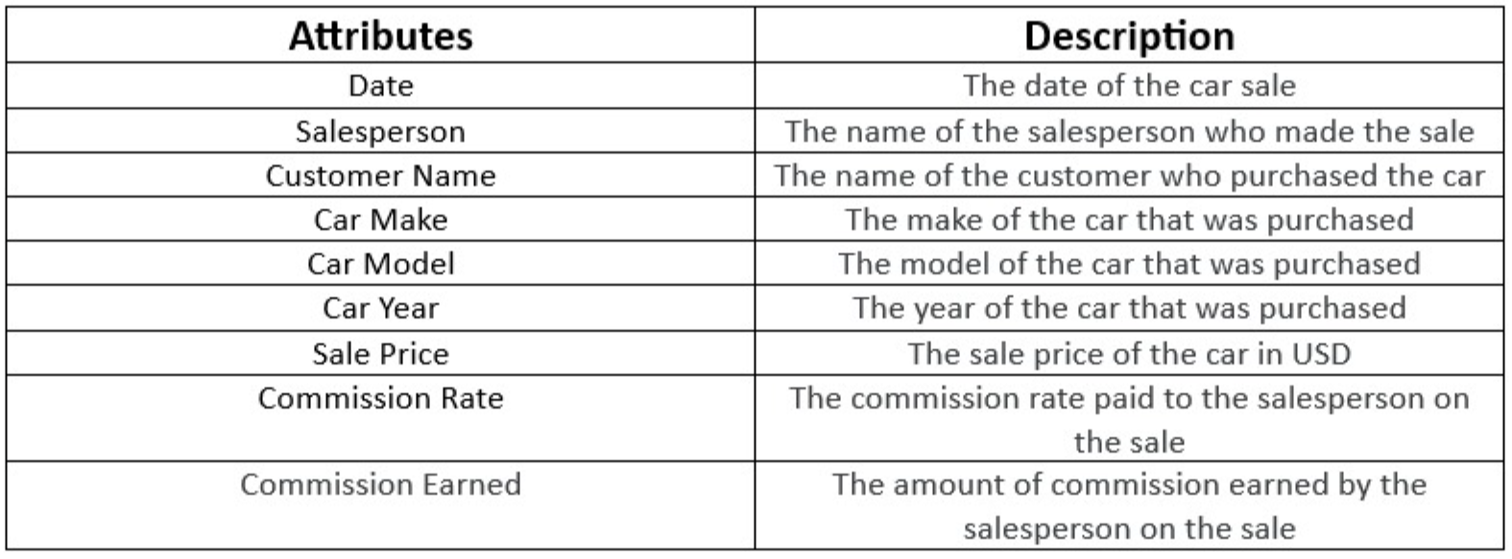

Slide 5
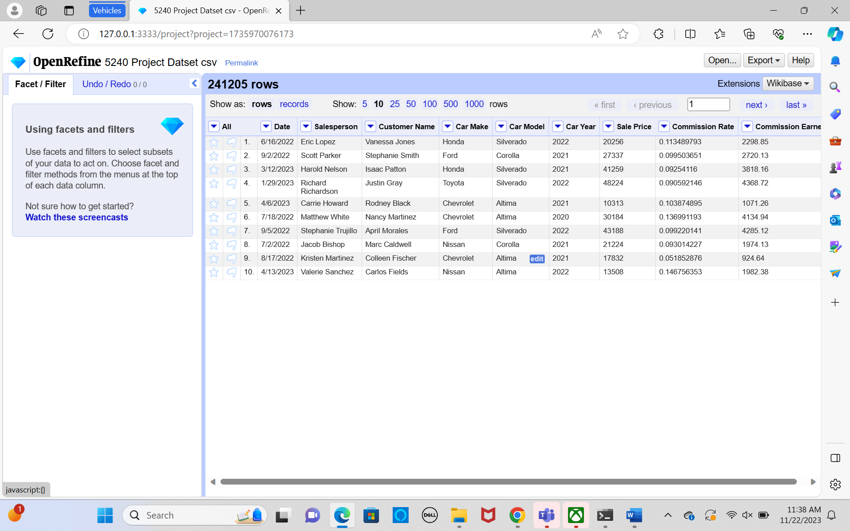
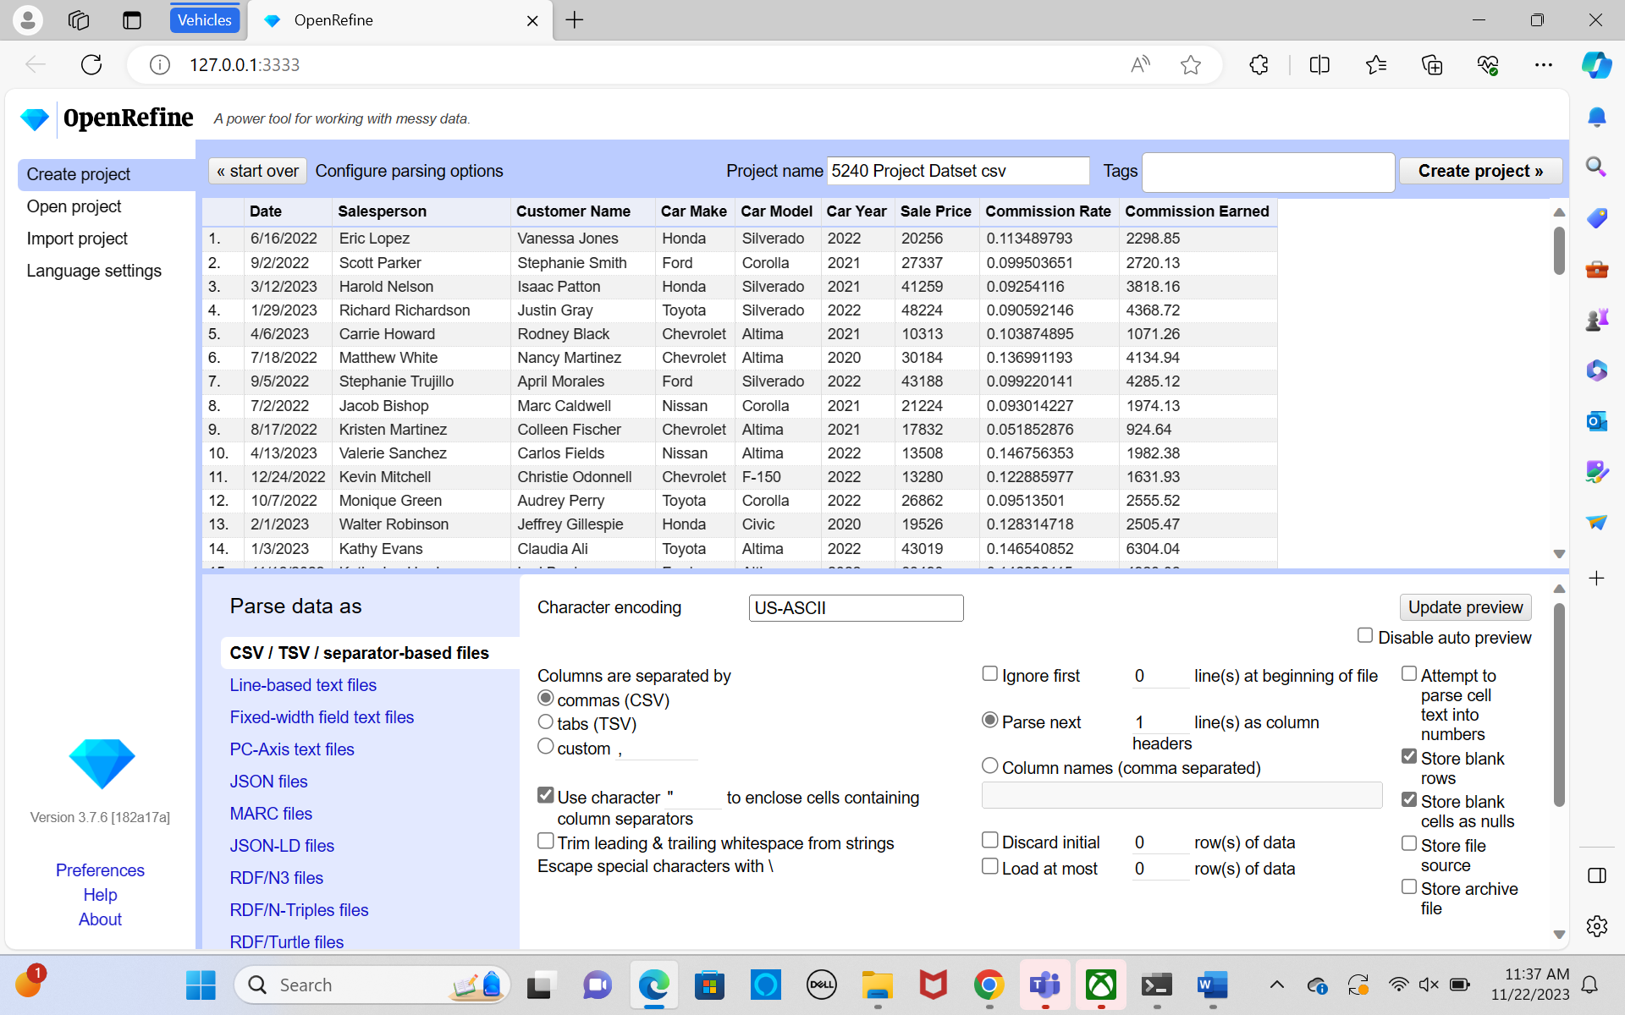
Data Pre-Processing with Open Refine
It is evident that 241205 records have been loaded.

Slide 6
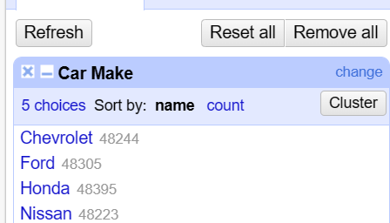
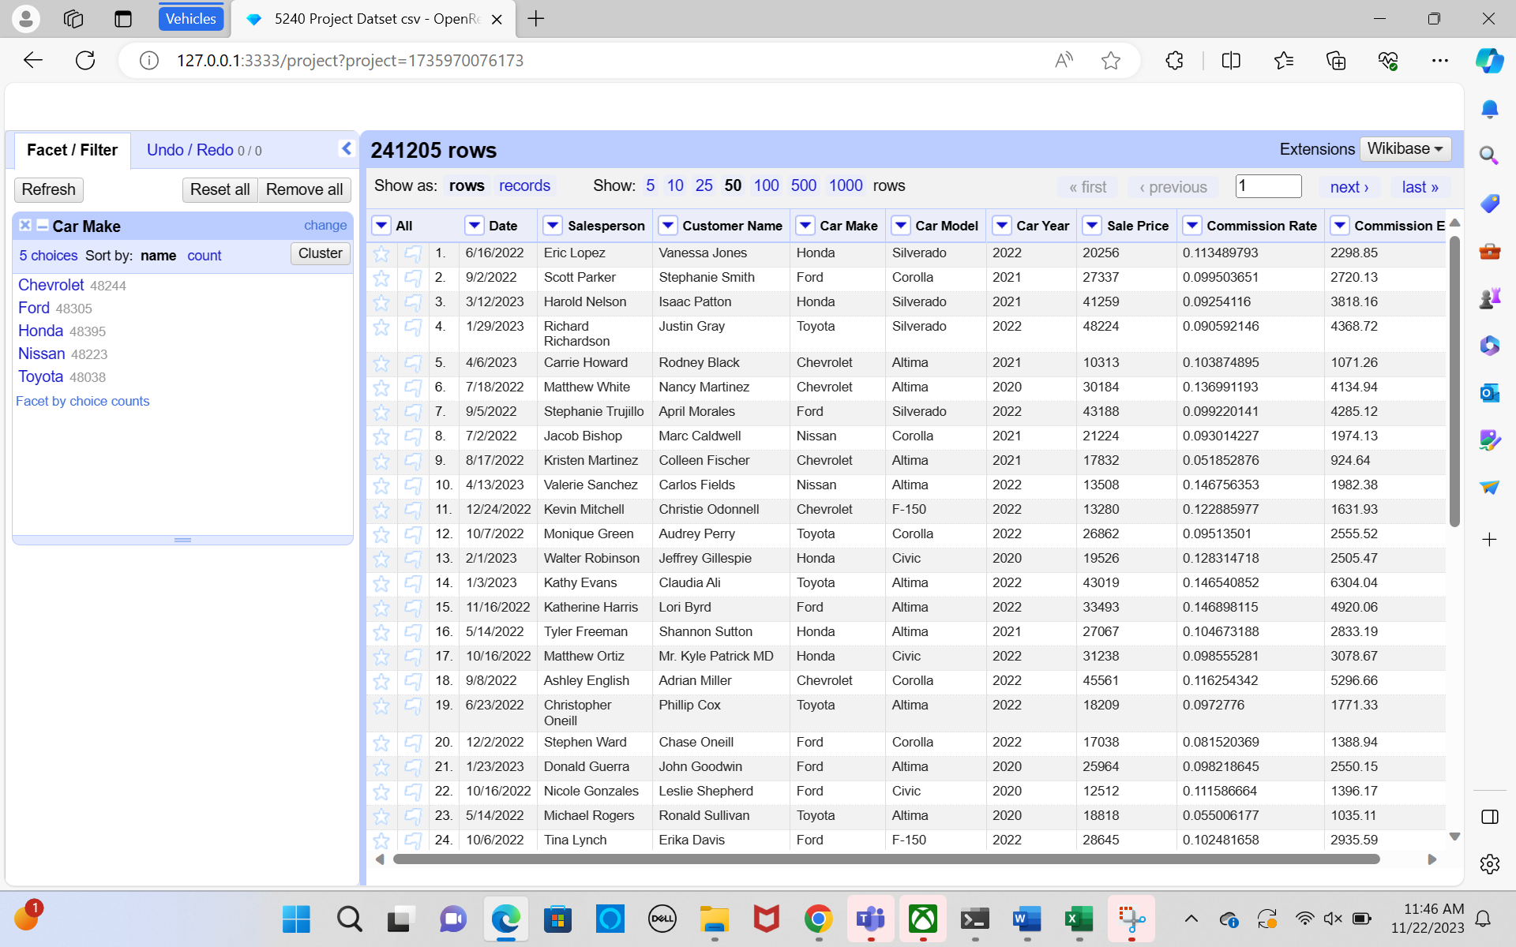
Analyzing data:
Finding unique values in the brand and model of a car using Text Facet
Five distinct auto brands are included in the dataset, as you can see.

Slide 7
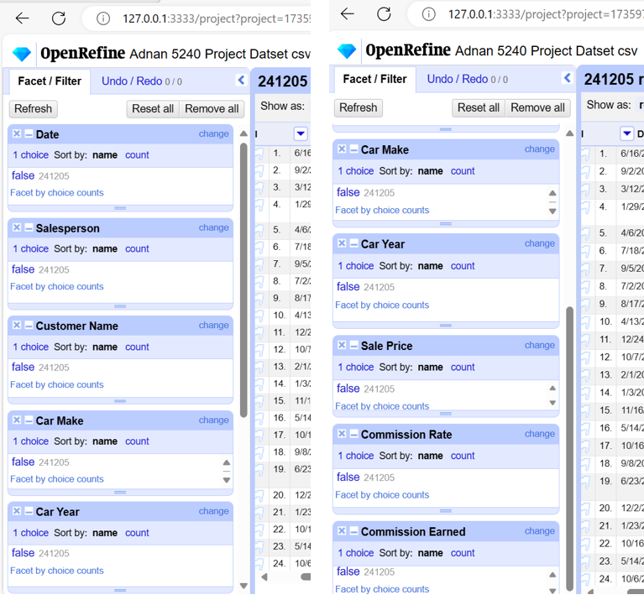
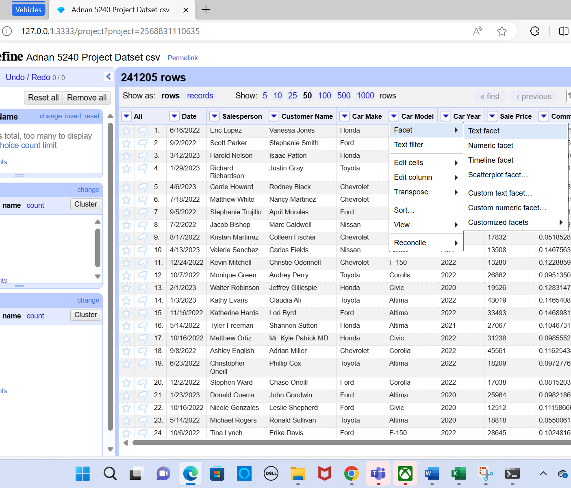
Checking for Duplicate values: examined for any typos, unusual terms, or words that could have been spelled incorrectly using the Facet and Text Facet options.

Slide 8
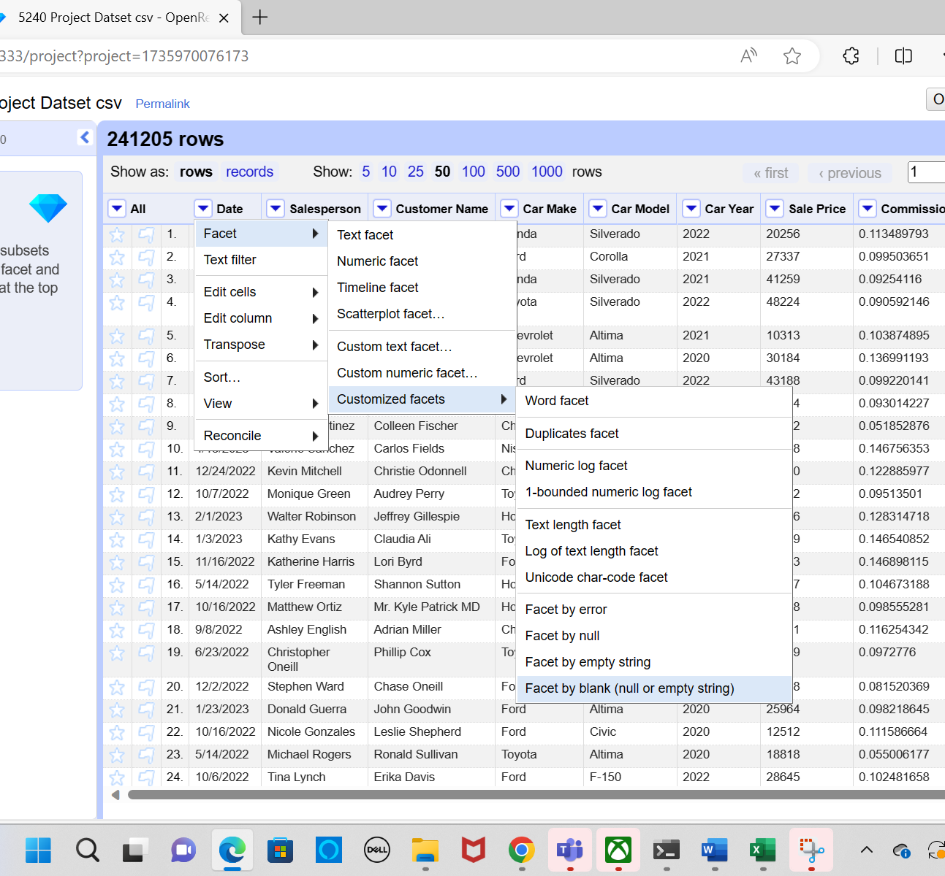
Checking for missing values:
To examine the missing data, I utilized the Facet Panel, which is accessible via the drop-down arrow adjacent to the column heading.
I have chosen "Facet by Blank" in the "Customized facets" facet menu option. have examined every column. The left side displays the
The number of missing or blank values in that column will now be shown by the facet. The quantity of missing data for every aspect is displayed below for all columns. As far as we can tell, no values are missing.

Slide 9
Type of Storage Used
Google Cloud Platform's (GCP) BigQuery was used to analyze the car sales data. BigQuery would be an optimal data warehouse solution for analyzing this automotive sales dataset to uncover actionable insights. Specifically, BigQuery is a serverless, highly scalable cloud data warehouse that enables running SQL queries over enormous datasets, in the petabyte range and beyond (Bhaumik, 2022). This makes it ideally suited for performing fast, complex analysis on large volumes of granular sales transaction information aggregated over time to guide data-driven business strategy decisions through a user-friendly SQL interface (Ali et al., 2021). It enables running SQL queries on huge amounts of data quickly and cost-effectively.
Reasons BigQuery is well-suited for the dealership's needs:
Performance - Advanced capabilities ensure fast SQL queries, even on billions of rows of granular sales transactions over time(Cheng, 2022). This allows rapid analysis.
Cost - As a serverless platform, BigQuery is very cost efficient compared to traditional data warehouses because you only pay for what you use (Masmoudi, 2021). This saves money for the analysis.
Security - GCP meets major compliance standards like HIPAA for data privacy assurance when dealing with sensitive customer sales data (Ignyte Team, 2020).
Accessibility - The SQL interface facilitates complex sales analytics without advanced data science expertise. Integrations with data visualization tools also enable interactive dashboards.

Slide 10
In summary,
BigQuery grants the dealership a flexible, affordable way to generate data-driven insights on inventory needs, customer trends, and sales team effectiveness to enhance strategic planning in a secure cloud platform. The savings and performance make it simpler than traditional warehouse approaches.
Therefore, GCP’s BigQuery would be an optimal data warehouse solution for analyzing this automotive sales dataset to uncover actionable insights. This makes it ideally suited for performing fast, complex analysis on large volumes of granular sales data to guide data-driven strategy decisions to improve inventory management, pricing structure, sales compensation, and promotional initiatives in a secure and compliant cloud environment.

Slide 11
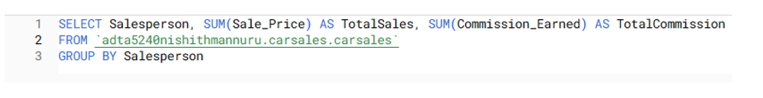
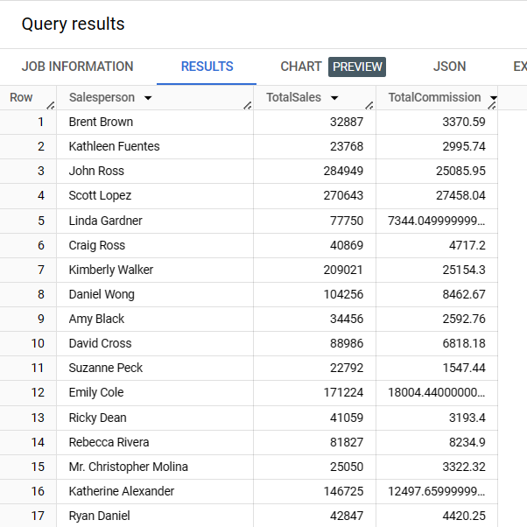

Query 1: The salesperson's total sales and commissions
We will create a query to compile performance data per representative over a predetermined time to assess how well each individual sales representative converts prospects into sales and commissions received. We may examine total sales income produced and total commissions made for everyone by choosing the salesperson's name, adding up the total dollar amounts of their closed sales, and totaling the commissions they have received across all transactions.

Slide 12
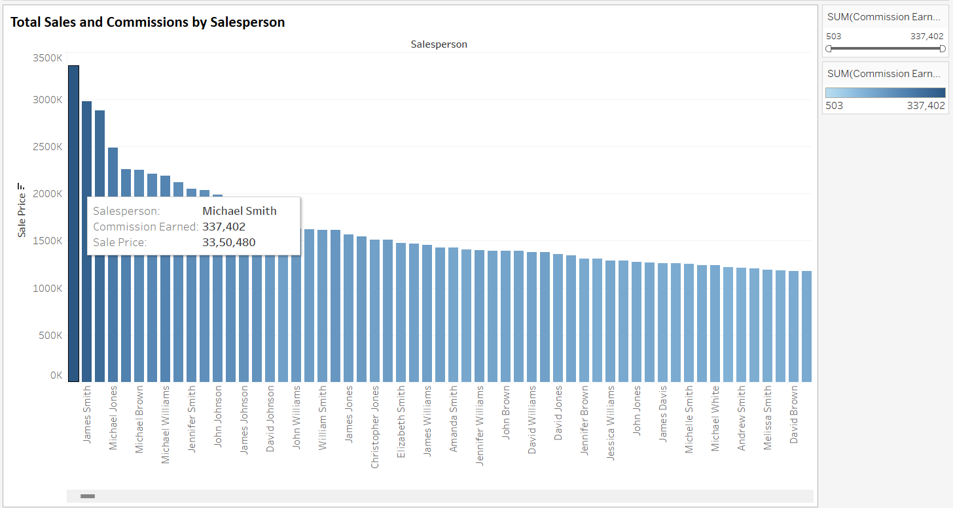
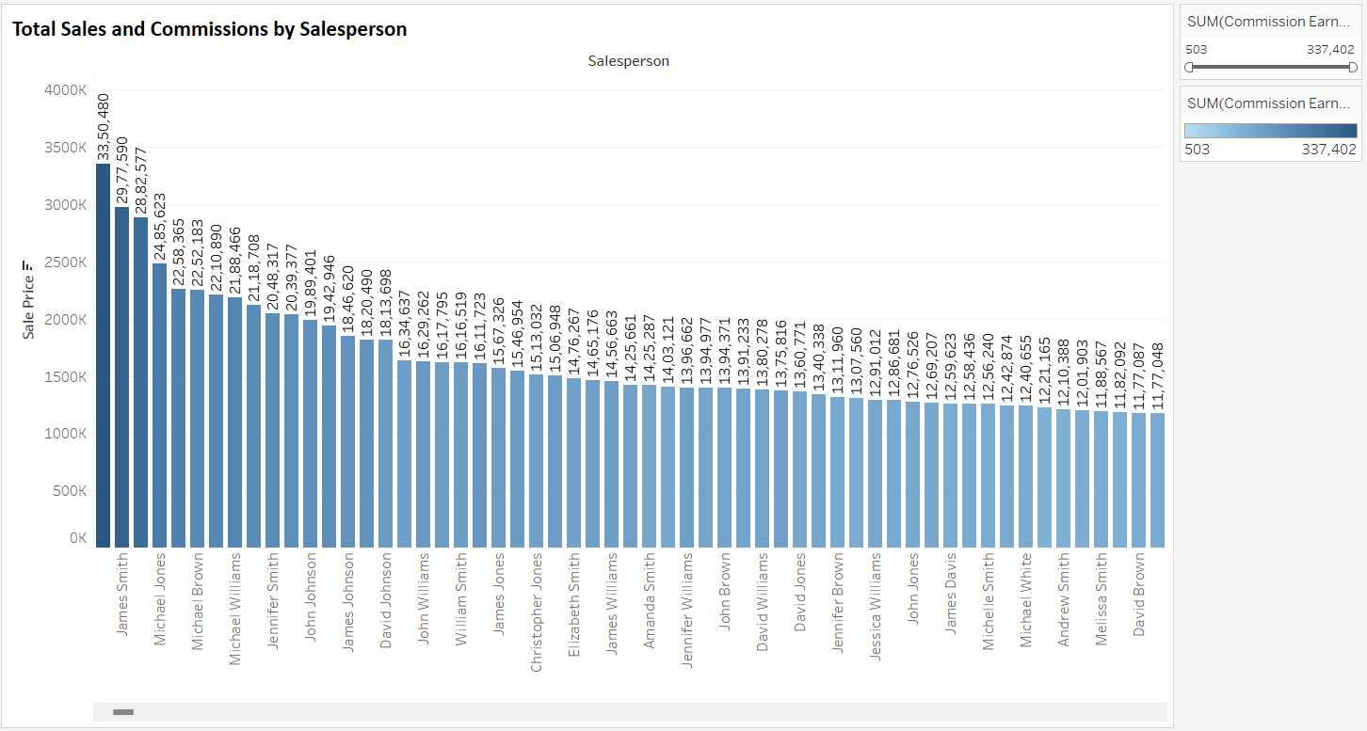
Visualization Looks
Query 1: Visualization look for The salesperson's total sales and commissions

Slide 13
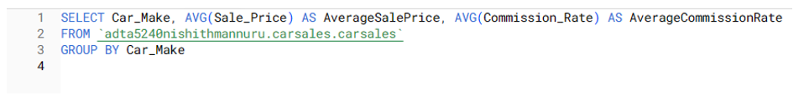
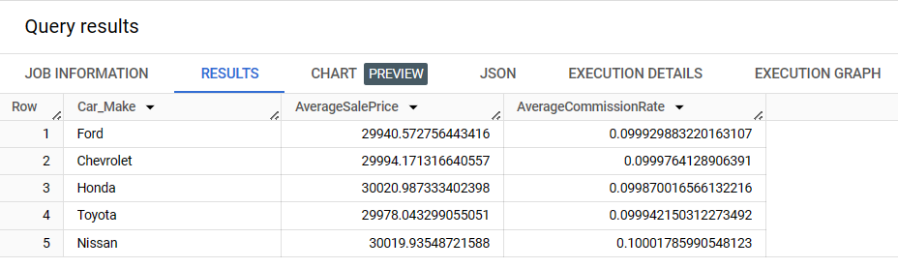
Query 2: By Car Make, Average Sale Price and Commission Rate
This shows patterns in price and profit for the many car models the dealership sells. Certain manufacturers probably permit increased commissions and selling prices. Making data-driven decisions to increase future profitability is made possible by knowing which now performs better. This includes modifying prices and incentives on certain car types, obtaining better manufacturer commission rates on top-selling makes, and optimizing inventory purchases to concentrate on high-selling makes and models. By matching sales, inventory, and manufacturer relationships with consumer car choices and purchase trends, the analysis helps maximize earnings.

Slide 14
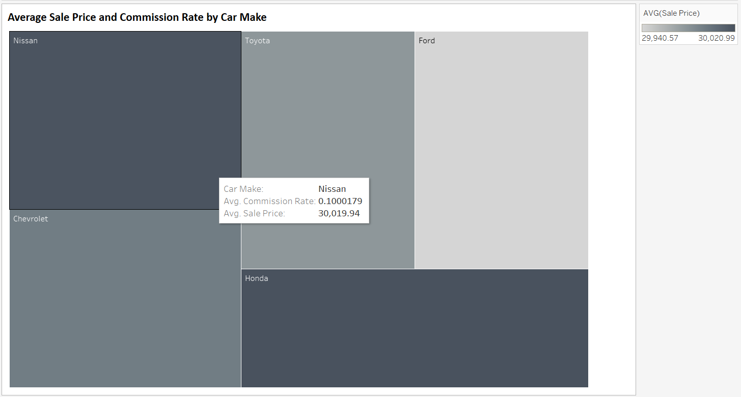
Query 2: Visualization look for Car Make, Average Sale Price, and Commission Rate

Slide 15

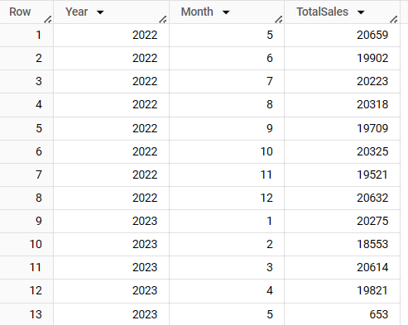
Query 3: Monthly Sales Trends
Result:
To identify patterns over the course of a year, this query will dissect the sales data from the previous 12 months by month. Record segmentation into monthly buckets is made possible by extracting the month property from the date field. Total monthly sales can be used to determine the presence of cyclical demand fluctuations, since certain months may have recurrent increases or decreases. This particularly emphasizes seasonality during summer driving, vacations, or year-end clearing for a single year. The detailed month-by-month study monitors volumes to determine the reasons for seasonal fluctuations in sales. To better match operations with anticipated volumes, inventory planning, sales staffing, promotions, and manufacturer procurement may be done by visualizing these demand cycles and comprehending specific monthly elements.

Slide 16
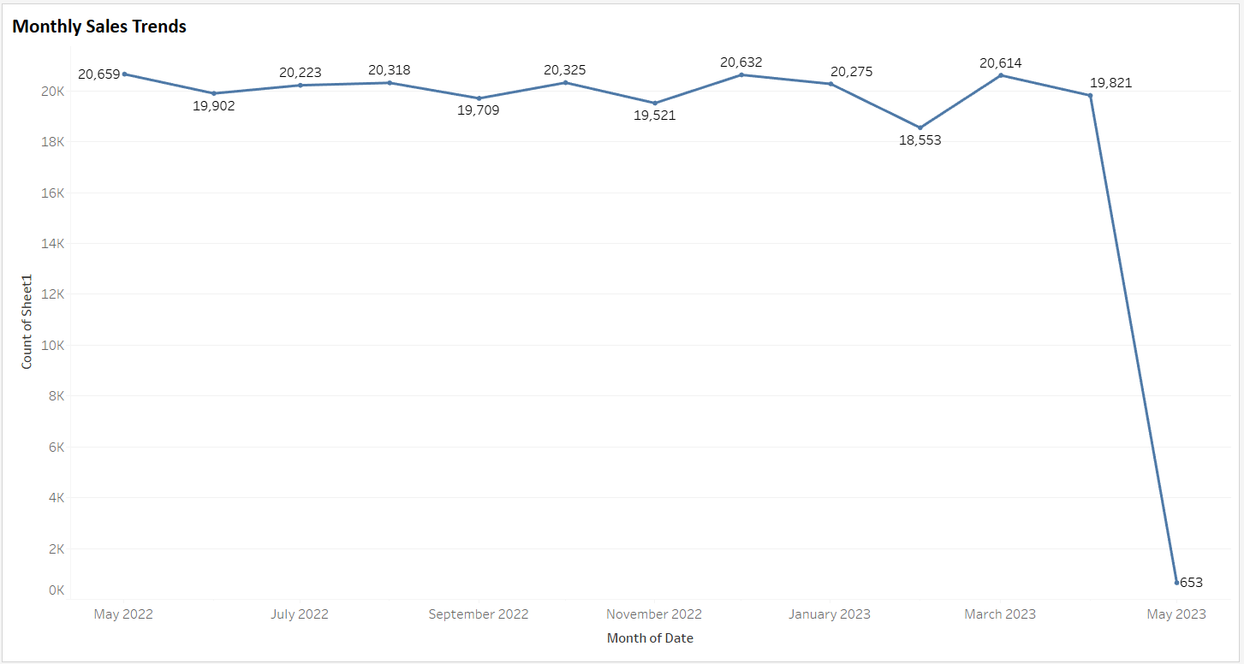
Query 3: Visualization look for Monthly Sales Trends

Slide 17
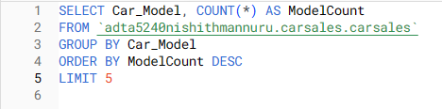
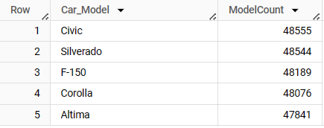
Query 4: Top-Selling Car Models
Identifying the automobile models that sell the most can help maximize future inventory investments. Model-level demand may be found by classifying sales records by model and calculating total sales for each model. Models are ranked from best to worst sellers when they are ordered by sales volume, decreasing. The most popular purchases are displayed by taking the top 5 models with the largest volume. Having more models available to customers increases their happiness, and having inventory that follows established sales trends increases income for businesses.

Slide 18
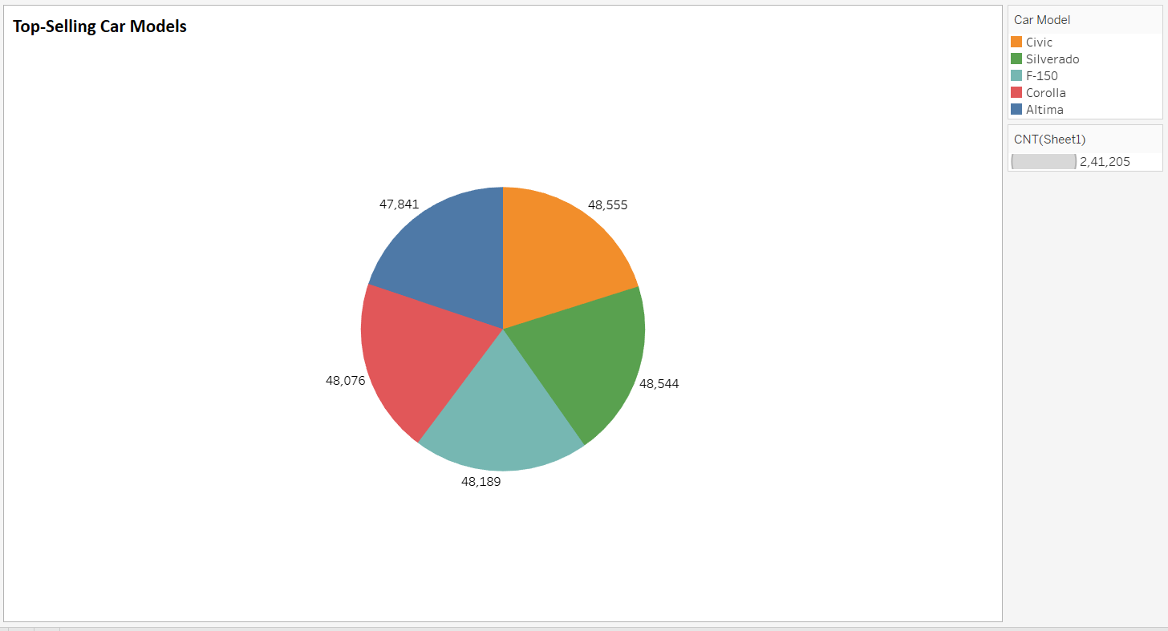
Query 4: Visualization Look for Top-Selling Car Models

Slide 19
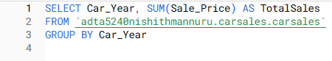
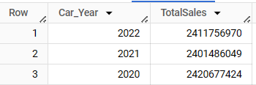
Query 5: Sales Breakdown by Car Year
Result:
Trends in the proportional demand for new vs used cars may be seen by breaking down sales performance by model year. The sales contribution of each vehicle age segment may be calculated by grouping sales data by model year and adding the total selling price per group. Because they are more expensive, brand-new model year cars may get the greatest overall sales revenue, according to the comparison. Alternatively, if the pricing differential outweighs the volume advantages from new automobiles, secondhand autos provide more profit overall. In order to maximize financial expenditures against proven sales demand throughout the age spectrum, trade-in offers, pre-owned vehicle acquisition at auction, and the purchase of new model year inventory are guided by an understanding of vehicle age preferences, and model-year.

Slide 20
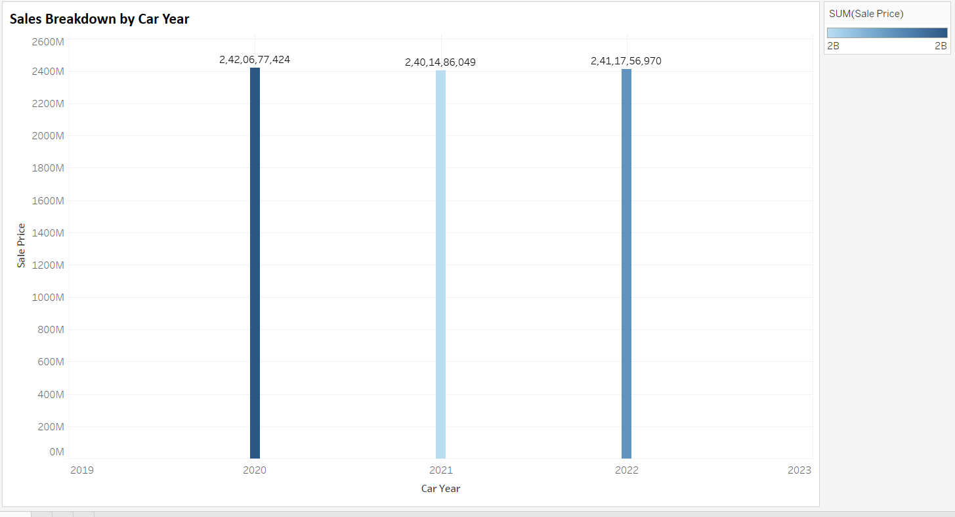
Query 5: Visualization Look Sales Breakdown by Car Year

Slide 21
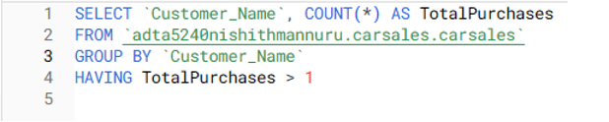

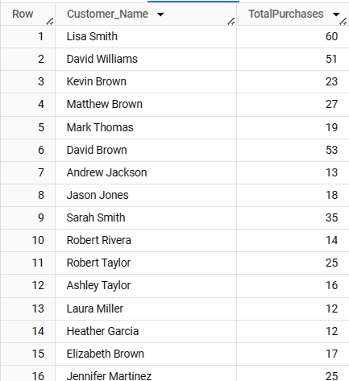
Query 6: Customer Loyalty
Sales data analysis identifies devoted repeat customers by highlighting situations in which a single consumer has made many car purchases over time. These consumers probably have a positive ownership experience, continue to be brand loyal, or have continuing automotive demands. Knowing which of our top clients are most likely to come back enables us to design tailored loyalty programs with exclusive benefits for their ongoing support. Further retention strategies, such as trade-in bonuses and service discounts, may encourage more repeat business.
Result::

Slide 22
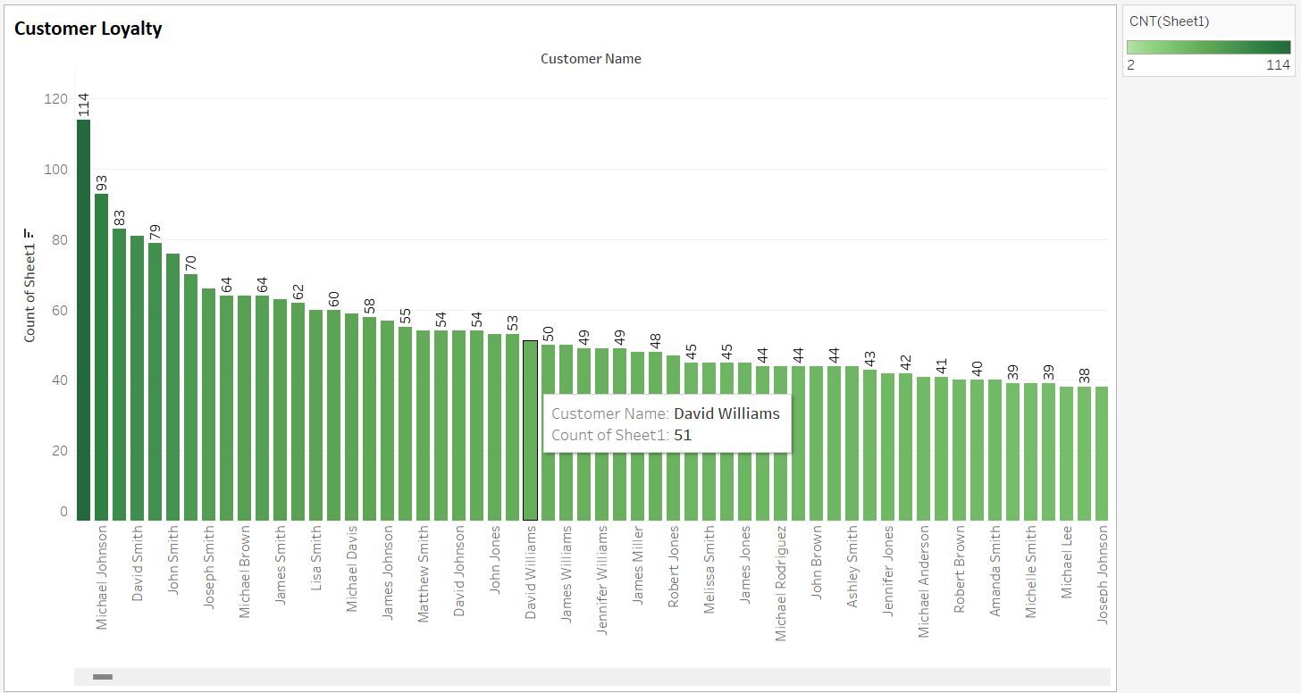
Query 6: Visualization Look for Customer Loyalty

Slide 23
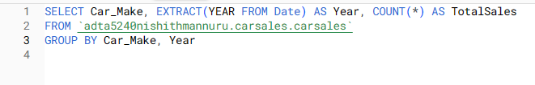
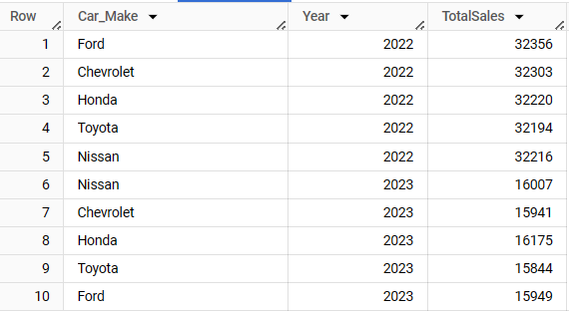
Query 7: Car Make Popularity Over Time
Result:
Future decision-making and strategy adjustments are guided by tracking customer preference shifts for vehicles over time. After extracting the automobile make and year from the sale date, the query puts all sales records together. This data format allows for the yearly analysis of make-level demand. Finding a pattern of strong sales reinforces the need for dealers to continue building connections with their manufacturers and receiving incentives. When operations are adjusted in response to fluctuations in consumer preferences, showroom inventory, technician training, manufacturer relationships, and sales initiatives are all in line with the dynamically changing market conditions that drive sales growth.

Slide 24
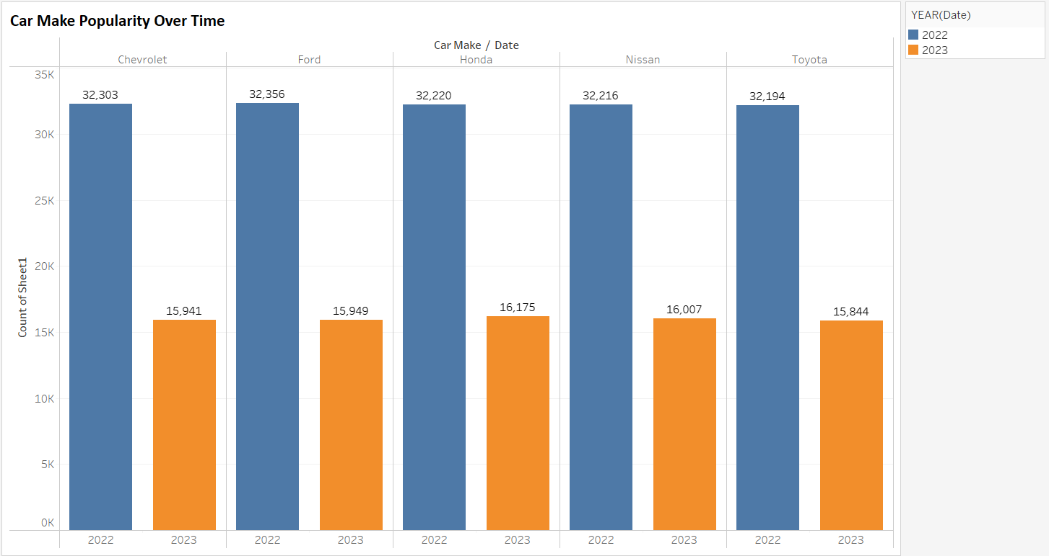
Query 7: Visualization Look for Car Make Popularity Over Time

Slide 25

Group Responsibilities
Nishith Reddy Mannuru:
Analyze the dataset and formulate the questions based on the problem statement with references. Worked on SQL queries.
Adnan Shareef: Has worked on cleaning the dataset and analyze the data set before loading. Helped Aseef in the Presentation.
Praveen Reddy Kadasani: Worked on Data Visualization(Tableau) based on the results obtained from SQL queries and provided related references.
Aseef Basha Shaik: Worked on Powerpoint and made the presentation easy to understand.
Yog Chaudhary: Helped in forming query and provided support to team members. Provided help to team members with their tasks.

Slide 26
References
Ali, M. H., Hosain, M. S., & Hossain, M. A. (2021). Big Data analysis using BigQuery on cloud computing platform. Australian JofEng Inno Tech, 3(1), 1-9.
Bhaumik, S. (2022, November 1). BigQuery: Basics & Internals: Part # 1 [Medium]. Google Cloud - Community. https://medium.com/google-cloud/bigquery-basics-internals-part-1-9eda52b65960
Cheng, C. (2022). 14 Best Practices to Tune BigQuery SQL Performance. Medium. https://towardsdatascience.com/14-ways-to-optimize-bigquery-sql-for-ferrari-speed-at-honda-cost-632ec705979
Ignyte Team. (2020, January 5). Platform Compliance & Risk Management. https://www.ignyteplatform.com/platform-compliance-risk-management/
Masmoudi, A. (2021, May 27). BigQuery Cost Efficiency. Medium. https://datadice.medium.com/bigquery-cost-efficiency-a6223b46376c

Slide 27


